Slide 1

Sparse and Redundant Representations and Their Applications in
Signal and Image Processing (236862)
Section 3: Pursuit Algorithms – Practice & Theory
Winter Semester, 2018/2019
Michael (Miki) Elad

Slide 2
Meeting Plan
Quick review of the material covered
Addressing issues raised by other learners
Answering questions from the students and getting their feedback
Discussing a new material
Administrative issues – the PROJECTS

Slide 3
Overview of the Material
Greedy Pursuit Algorithms - The Practice
Defining Our Objective and Directions
Greedy Algorithms - The Orthogonal Matching Pursuit
Variations over the Orthonormal Matching Pursuit
The Thresholding Algorithm
A Test Case: Demonstrating and Testing Greedy Algorithms
Relaxation Pursuit Algorithms
Relaxation of the L₀ Norm – The Core Idea
A Test Case: Demonstrating and Testing Relaxation Algorithms
Guarantees of Pursuit Algorithms
Our Goal: Theoretical Justification for the Proposed Algorithms
Equivalence: Analyzing the OMP Algorithm
Equivalence: Analyzing the THR Algorithm
Equivalence: Analyzing the Basis-Pursuit Algorithm – Part 1
Equivalence: Analyzing the Basis-Pursuit Algorithm – Part 2

Slide 4
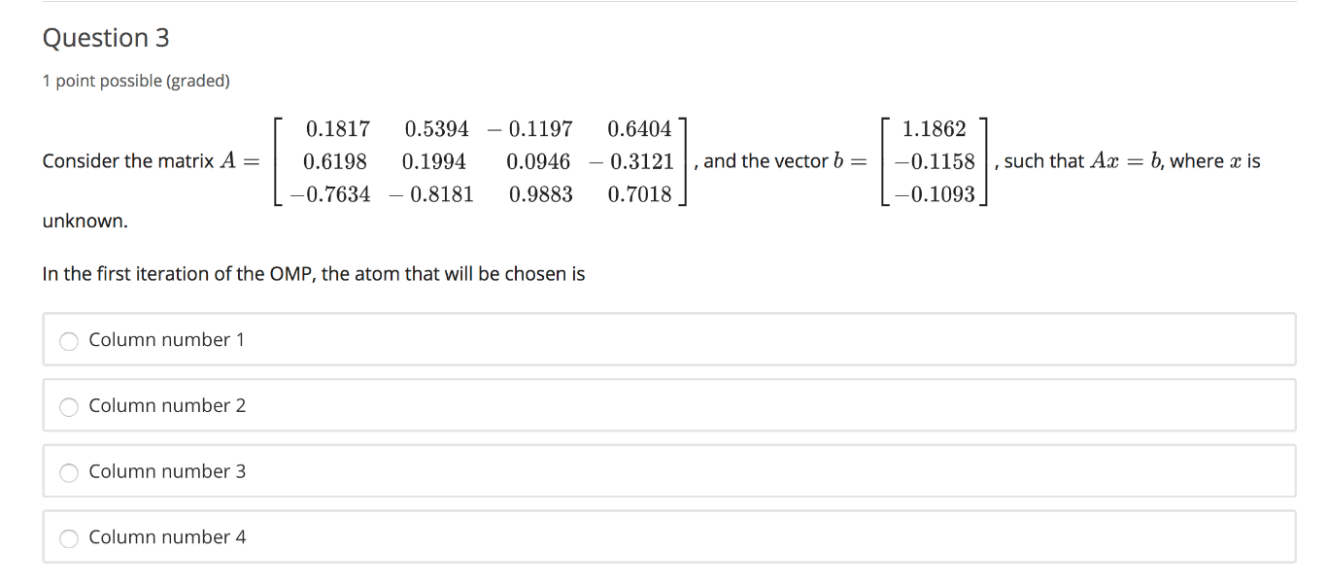
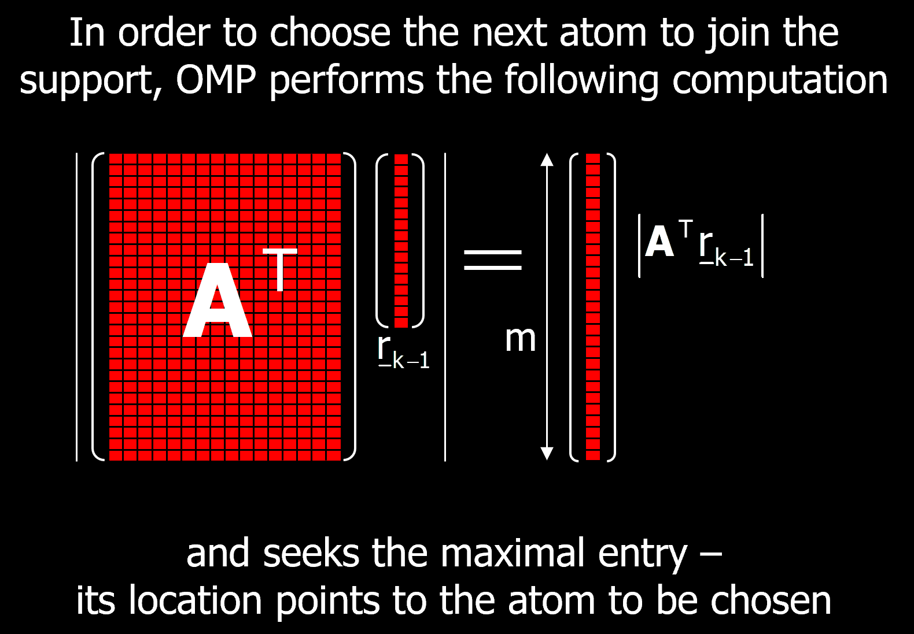
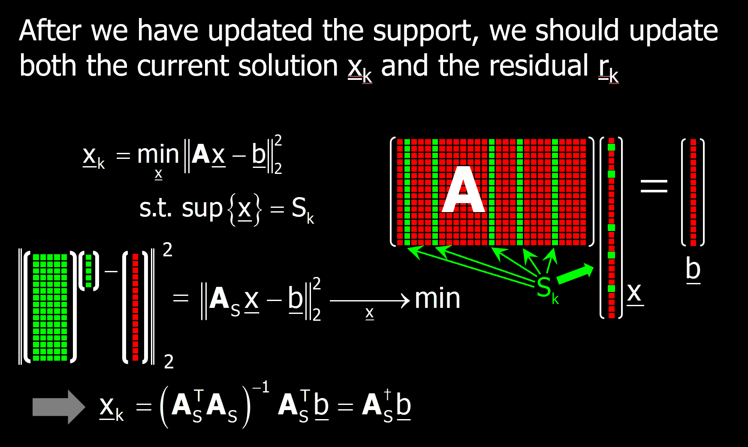

A=[0.1817 0.5394 -0.1197 0.6404; 0.6198 0.1994 0.0946 -0.3121; -0.7634 -0.8181 0.9883 0.7018];
b=[1.1862 -0.1158 -0.1093]';
% Sanity check: Are the atoms normalized?
disp(diag(A'*A));
% OMP first stage:
disp(abs(A'*b)); % Clearly, the 4th atom will be chosen
support=[4];
As = A(:,support)
disp(As'*As) % this is a scalar (1!)
disp(inv(As'*As)*As'*b) % this is a first non-zero coefficient
Issues Raised by Other Learners
Question 3 from the Quiz:

Slide 5
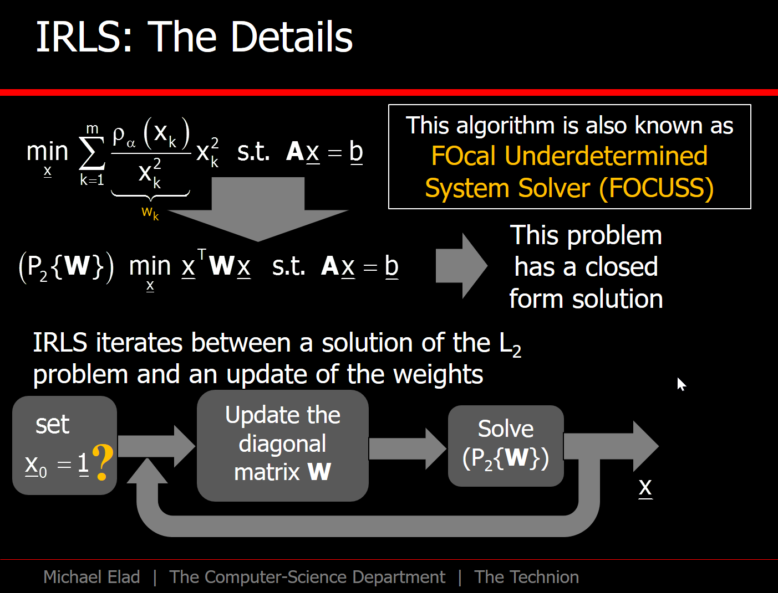
Issues Raised by Other Learners
Question about the IRLS Algorithm:
The weights in the IRLS always have x_k in the denominator. This means that all x_k must be non-zero in all iterations. Hence the final vector x always has non-zero values in all entries. Put in other words, x is dense, contrary to the purpose of the sparse representation. I think I have some misunderstanding of the relaxation algorithm. Please correct me.

Slide 6
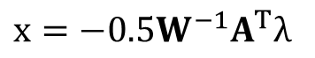
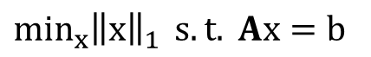
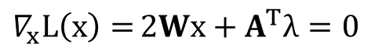
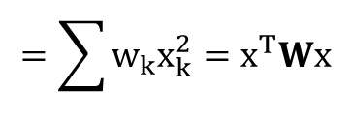
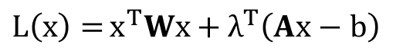
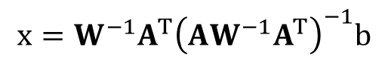
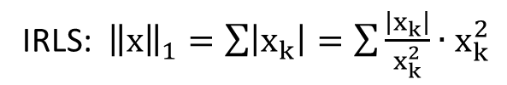
% Synthesize the problem
n = 50;
m = 100;
k = 16;
A = randn(n,m);
A = A*diag(1./sqrt(diag(A'*A)));
support = randperm(m);
support = support(1:k);
x = zeros(m,1);
x(support) = randn(k,1);
b = A*x;
%=============================================
% Solve with L1: min ||x||_1 s.t. Ax=b
solution = linprog(ones(2*m,1),[],[],[A, -A],b,zeros(2*m,1),ones(2*m,1)*100);
x_L1 = solution(1:m)-solution(m+1:end);
figure(1); clf;
plot(x);
hold on;
plot(x_L1,'ro')
axis([0 m -3 3]);
%=============================================
% Solve the L1 indirectly by IRLS
x_IRLS = ones(m,1);
W = eye(m);
for iter = 1:1:40
figure(1); clf;
plot(x);
hold on;
plot(x_IRLS,'ro')
axis([0 m -3 3]);
pause;
lambda = (A*inv(W)*A')\b;
x_IRLS_new = inv(W)*A'*lambda;
x_IRLS = x_IRLS_new*1+x_IRLS*0;
pos = abs(x_IRLS)<1e-3;
w = 1./abs(x_IRLS);
w(pos) = 1e3;
W = diag(w);
end
Issues Raised by Other Learners
$\min_{x}{{\left\|x\right\|}_{1}}{ s.t. Ax=b}$
IRLS: ${\left\|x\right\|}_{1}=\sum{\left|x_{k}\right|}=\sum{\frac{\left|x_{k}\right|}{x_{k}^{2}}∙x_{k}^{2}}$
$$=\sum{w_{k}x_{k}^{2}}=x^{T}Wx$$
$L\left(x\right)={x^{T}Wx}+λ^{T}\left(Ax−b\right)$
$∇_{x}L\left(x\right)={2Wx}+A^{T}λ=0$
$x=−0.5{W^{−1}A}^{T}λ$
$Ax=b: −0.5A{W^{−1}A}^{T}λ=b$ → $λ=−2{\left(A{W^{−1}A}^{T}\right)}^{−1}b$
$$x={W^{−1}A}^{T}{\left(A{W^{−1}A}^{T}\right)}^{−1}b$$

Slide 7

Your Questions and Feedback

Slide 8
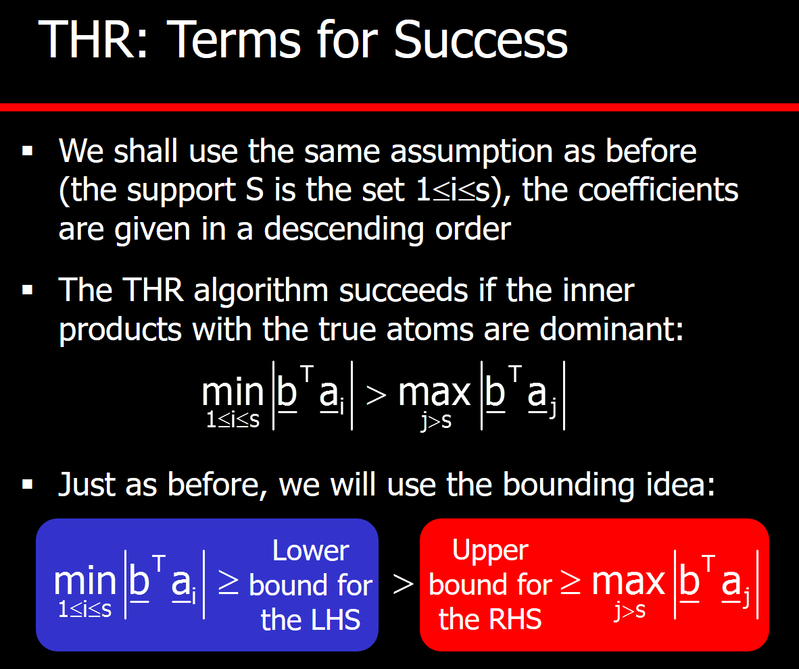
New Material?
The THR Algorithm is analyzed in the course for the deterministic (worst-case) scenario
Can we offer a better analysis? One that will expose a more optimistic behavior?

Slide 9
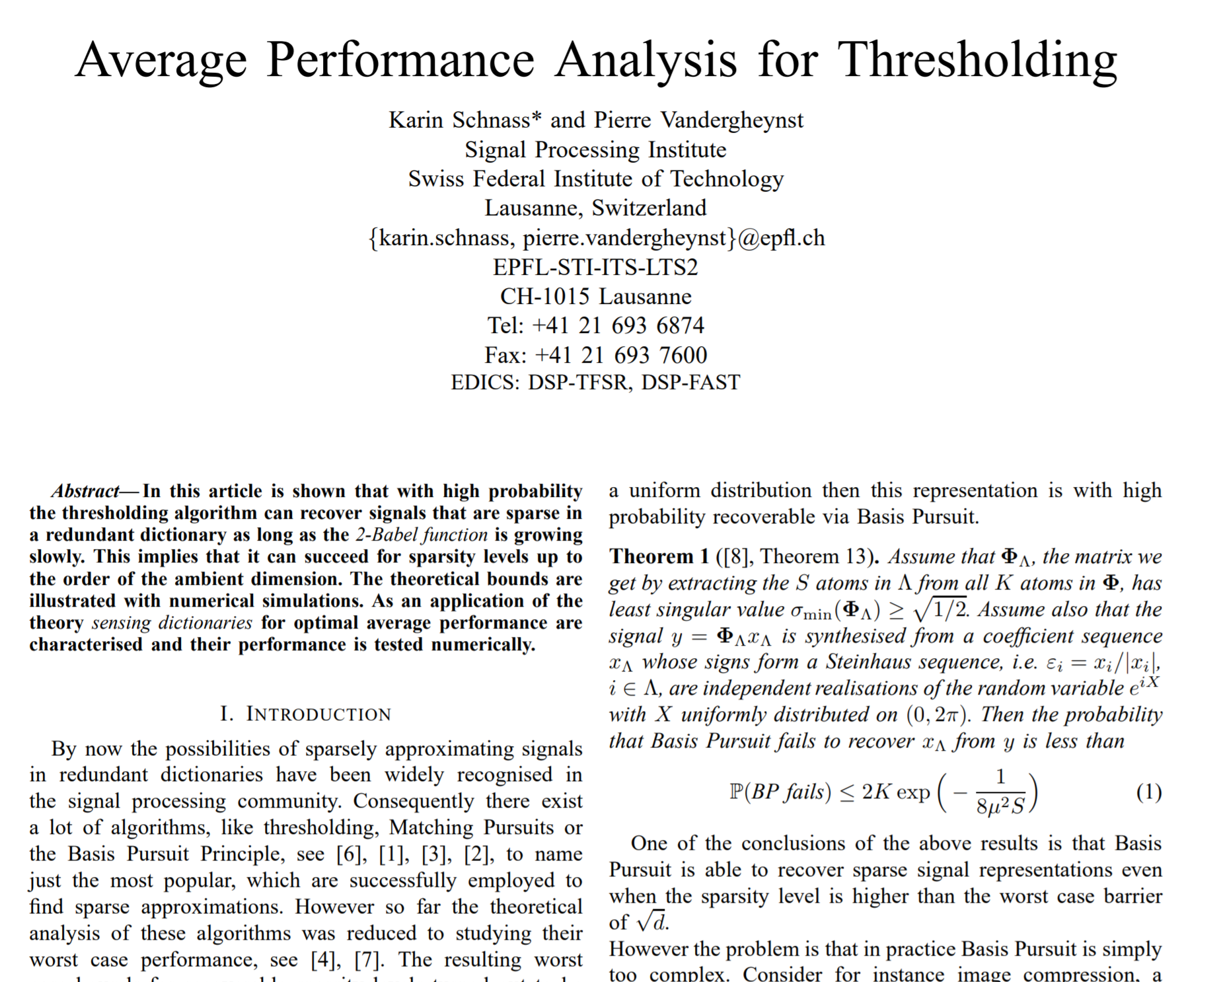
New Material?
We bring such an analysis from [Schnass & Vandergheynst, 2007]

Slide 10
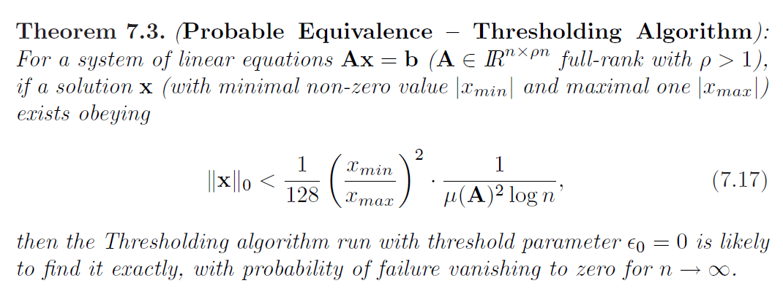
Our Goal: Proving this Theorm

Slide 11
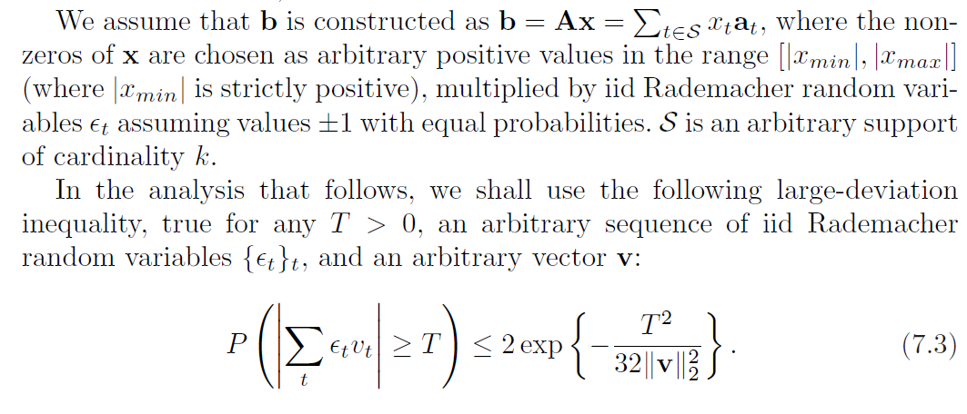
Preliminaries

Slide 12
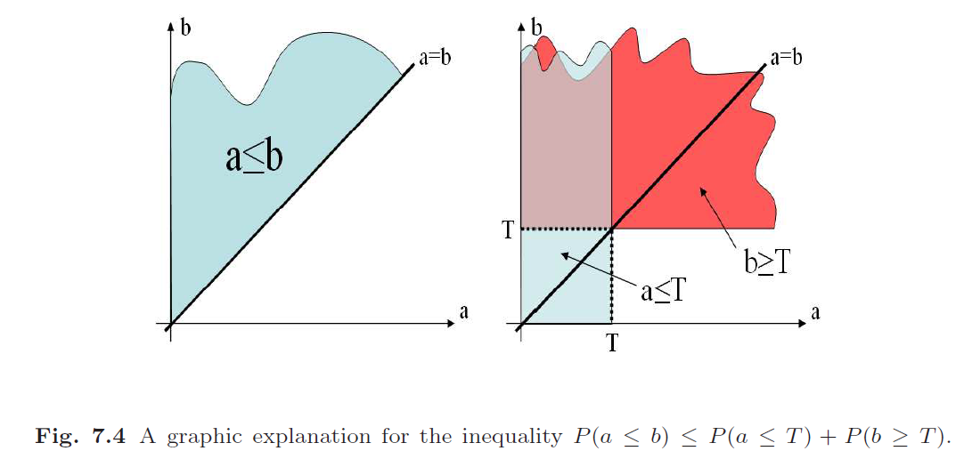
Preliminaries
Property 1: For all T, P(a≤b) ≤ P(a≤T) + P(b≥T)

Slide 13
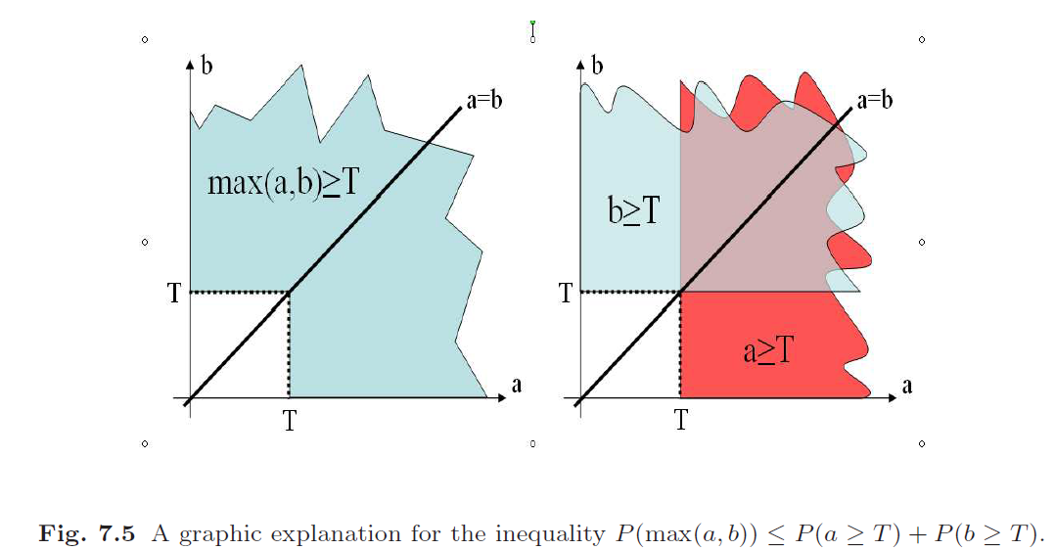
Preliminaries
Property 2: For all T, P(max[a,b]≥T) ≤ P(a ≥T) + P(b≥T)

Slide 14
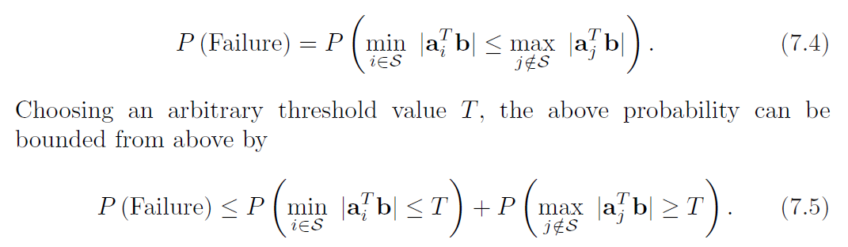
First Step – Simplification
Property 1
If we replace min|a_{i}^{T}b| in the first term by something smaller we increase the probability.
The same happens if we replace max|a_{j}^{T}b| in the second term by something larger.

Slide 15
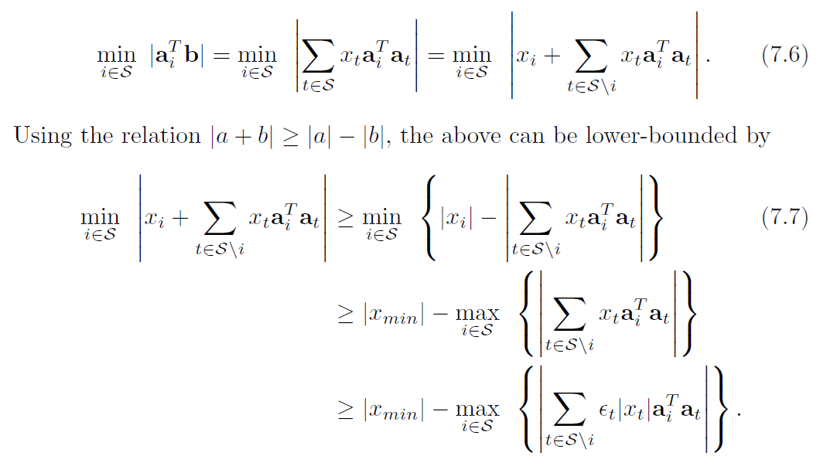
Lowering the Term: min |a_{i}^{T}b|

Slide 16
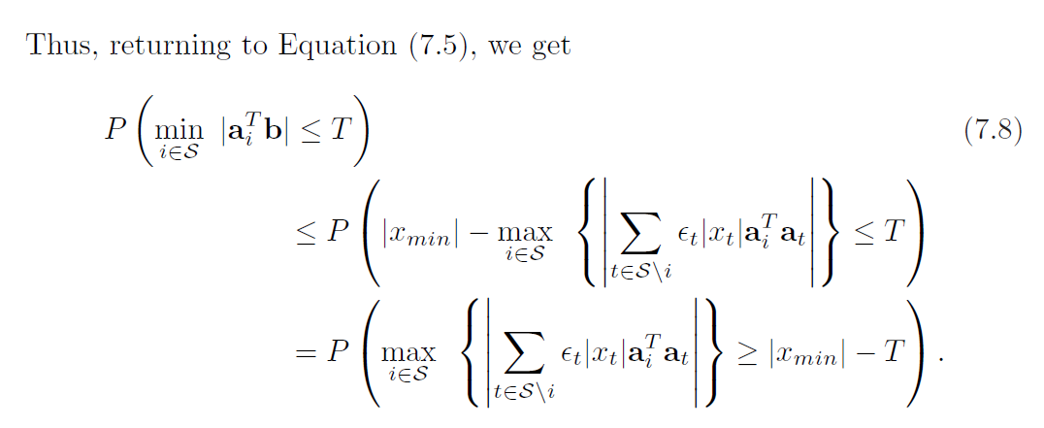
Lowering the Term: min |a_{i}^{T}b|
Recall:

Slide 17
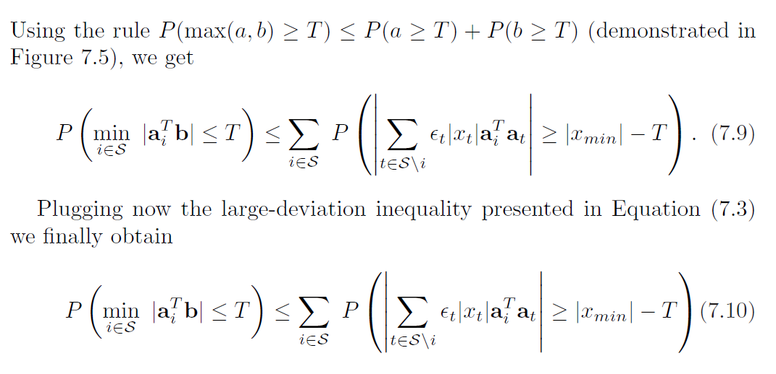
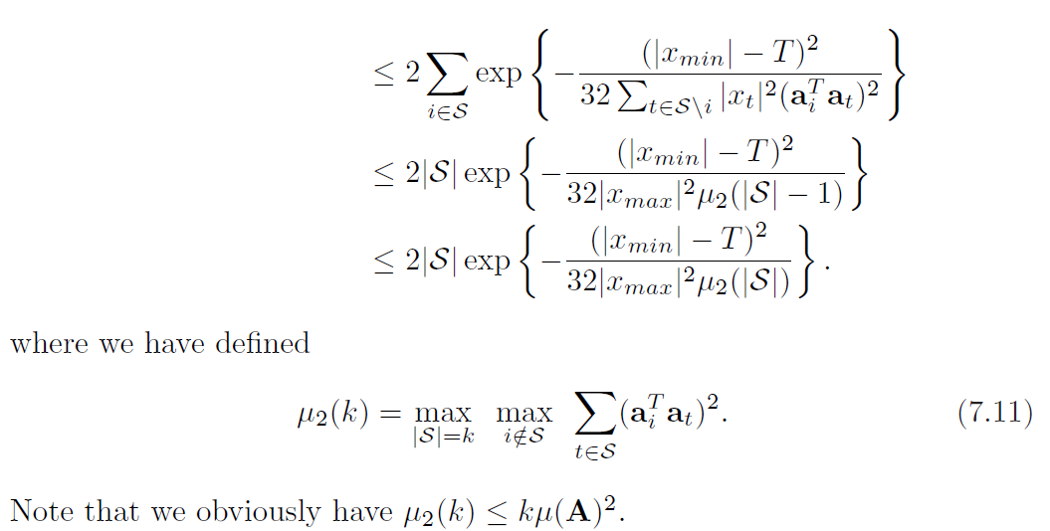
Lowering the Term: min |a_{i}^{T}b|
Property 2

Slide 18
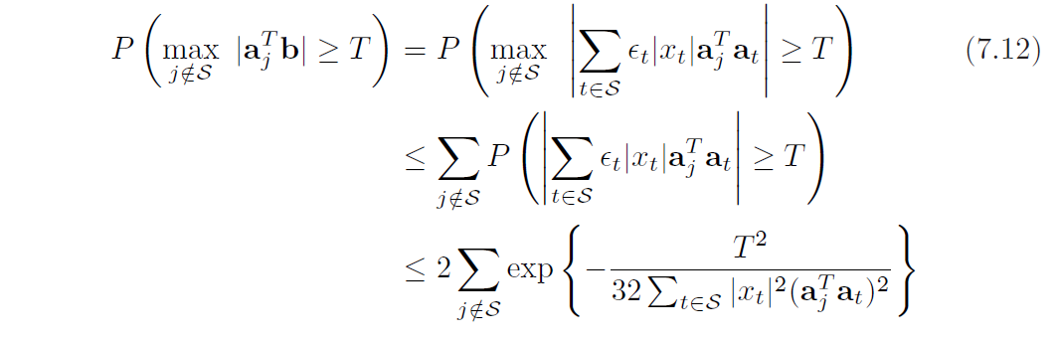

Magnifying the Term: max |a_{j}^{T}b|
(Property 2)

Slide 19
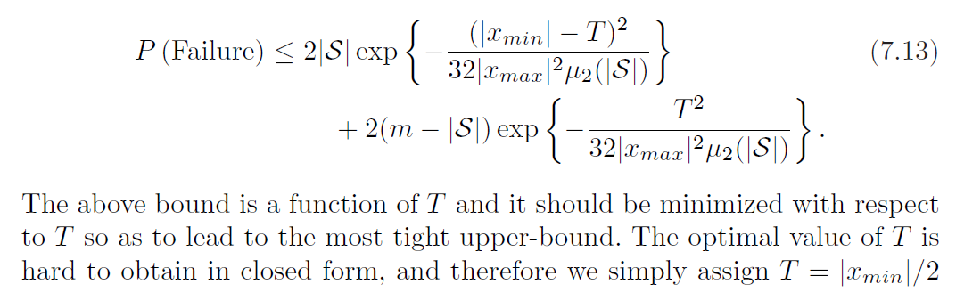
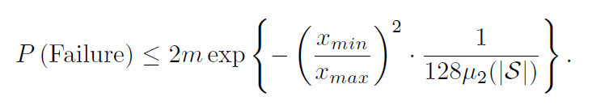
We are Nearly Done

Slide 20
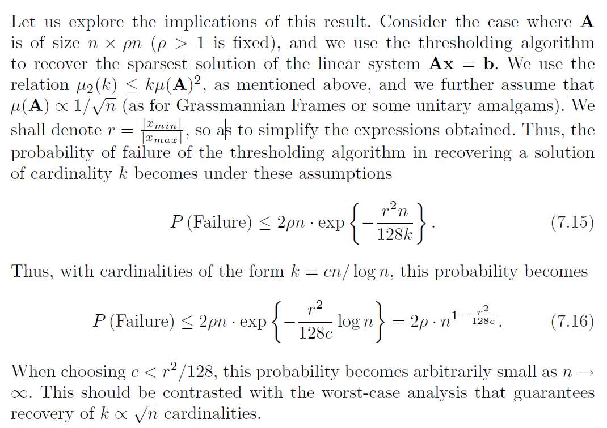
Should we be Happy with this Result?
The matrix A of size n×ρn
Assume μ₂(k)=kμ(A)²=k/n
Denote r=|x_{min}|/|x_{max}|
Cardinality is k
If k = c⋅n/log n

Slide 21
To Conclude

Slide 22
Administrative Issues
We released a list of papers for your final projects – please start looking at them
Lets discuss the mid- and the final-projects in Course 1

Slide 23



